Slide 1
Mobile Apps - Types
Pravin Y Pawar

Slide 2
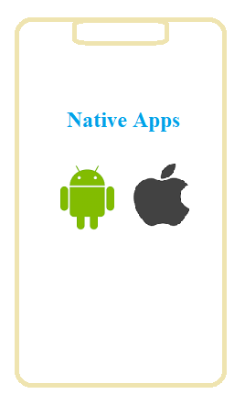
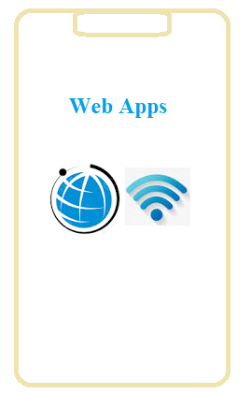

Mobile Apps - Types
Three!

Slide 3
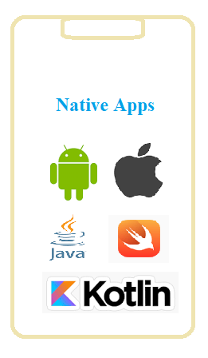
Native Apps
Developed specifically for a particular mobile device
Installed directly onto the device itself
Needs to be downloaded via app stores such as
Apple App Store
Google Play store, etc.
Built for specific mobile operating system such as
Apple iOS
Android OS
An app made for Apple iOS will not work on Android OS or Windows OS
Need to target all major mobile operating systems
require more money and more effort

Slide 4
Native Apps
Pros and Cons
Pros
Can be Used offline - faster to open and access anytime
Allow direct access to device hardware that is either more difficult or impossible with a web apps
Allow the user to use device-specific hand gestures
Gets the approval of the app store they are intended for
User can be assured of improved safety and security of the app
Cons
More expensive to develop - separate app for each target platform
Cost of app maintenance is higher - especially if this app supports more than one mobile platform
Getting the app approved for the various app stores can prove to be long and tedious process
Needs to download and install the updates to the apps onto users mobile device

Slide 5
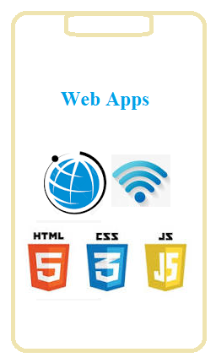
Web Apps
Basically internet-enabled applications
Accessible via the mobile device's Web browser
Don't need to downloaded and installed onto mobile device
Written as web pages in HTML and CSS
with the interactive parts in Jquery, JavaScript etc.
Single web app can be used on most devices capable of surfing the web
irrespective of the operating system

Slide 6
Web Apps
Pros and Cons
Pros
Instantly accessible to users via a browser
Easier to update or maintain
Easily discoverable through search engines
Development is considerably more time and cost-effective than development of a native app
common programming languages and technologies
Much larger developer base.
Cons
Only have limited scope as far as accessing a mobile device's features is concerned
device-specific hand gestures, sensors, etc.
Many variations between web browsers and browser versions and phones
Challenging to develop a stable web-app that runs on all devices without any issues
Not listed in 'App Stores'
Unavailable when offline, even as a basic version

Slide 7
Hybrid Apps
Part native apps, part web apps
Like native apps,
available in an app store
can take advantage of some device features available
Like web apps,
Rely on HTML, CSS , JS for browser rendering
The heart of a hybrid-mobile application is application that is written with HTML, CSS, and JavaScript!
Run from within a native application and its own embedded browser, which is essentially invisible to the user
iOS application would use the WKWebView to display application
Android app would use the WebView element to do the same function

Slide 8
Hybrid Apps
Pros and Cons
Pros
Don’t need a web browser like web apps
Can access to a device’s internal APIs and device hardware
Only one codebase is needed for hybrid apps
Cons
Much slower than native apps
With hybrid app development, dependent on a third-party platform to deploy the app’s wrapper
Customization support is limited

Slide 9
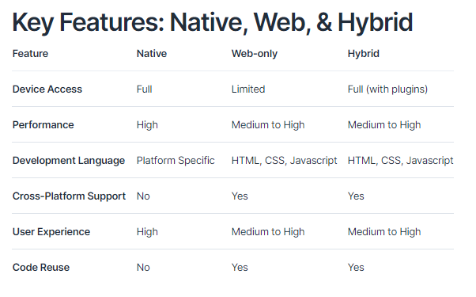
Compared!
Source : Ionic

Slide 10
Thank You!
In our next session:

